Slide 1
Restaurant Management And Table Reservation
Team members:
VYSHNAVI THIRUNAGARI (221202032)
DHEERAJ KUMAR MAHANKALI (221202033)
ISHANTH REDDY BETHELLI (221202034)
RAKSHITHA GUNDARAPU (221202039)
Under the guidance of
Dr. E. ARAVIND (Assoc. Professor)

Slide 2
Abstract
The restaurant industry is constantly evolving to meet the demands of a fast-paced and dynamic market. In this context, our project focuses on developing a comprehensive Restaurant Table Reservation System (RTRS) to revolutionize the traditional dining experience. This project aims to address the challenges faced by both customers and restaurant staff in the reservation process, enhancing overall efficiency and customer satisfaction. The Restaurant Table Reservation System is designed to provide a seamless and user-friendly interface for customers to make reservations. Utilizing modern web and mobile technologies, the system offers an intuitive booking platform that allows users to browse restaurant availability, select preferred time slots, and even choose specific tables based on their preferences. This ensures a personalized and efficient reservation process for customers, reducing the likelihood of no-shows and minimizing waiting times.

Slide 3
Introduction
Customer Experience
Increased Efficiency
Competitive Edge
Improving the overall dining experience by reducing waiting times and providing a seamless reservation process.
Enhancing the restaurant's operational efficiency by optimizing table allocation and streamlining the reservation process
Gaining a competitive advantage by providing a modern and convenient reservation system for the customers.

Slide 4
system requirements
Software requirements
Hardware requirements
Programming Languages:
1. HTML (Hypertext Markup Language)
2. CSS
3. JavaScript
4. PHP
Database Management System:
MySQL:
Processor: 13 or above
Hard Disc: above 50GB
Ram:1GB or above

Slide 5
Existing System
Manual Reservation
Long Wait Times
Traditional pen-and-paper method for recording and managing table reservations.
Customers experience frustration due to long waiting periods during peak hours.
Inefficient Allocation
Tables may not be optimally allocated, leading to reduced capacity utilization.

Slide 6
Proposed System
Online Reservations
Customers can book tables online, reducing the need for manual entries
Automated Allocation
Optimizing table allocation using intelligent algorithms for efficient seating.
Reservation Management
Managing, modifying, and canceling reservations with ease and accuracy.

Slide 7
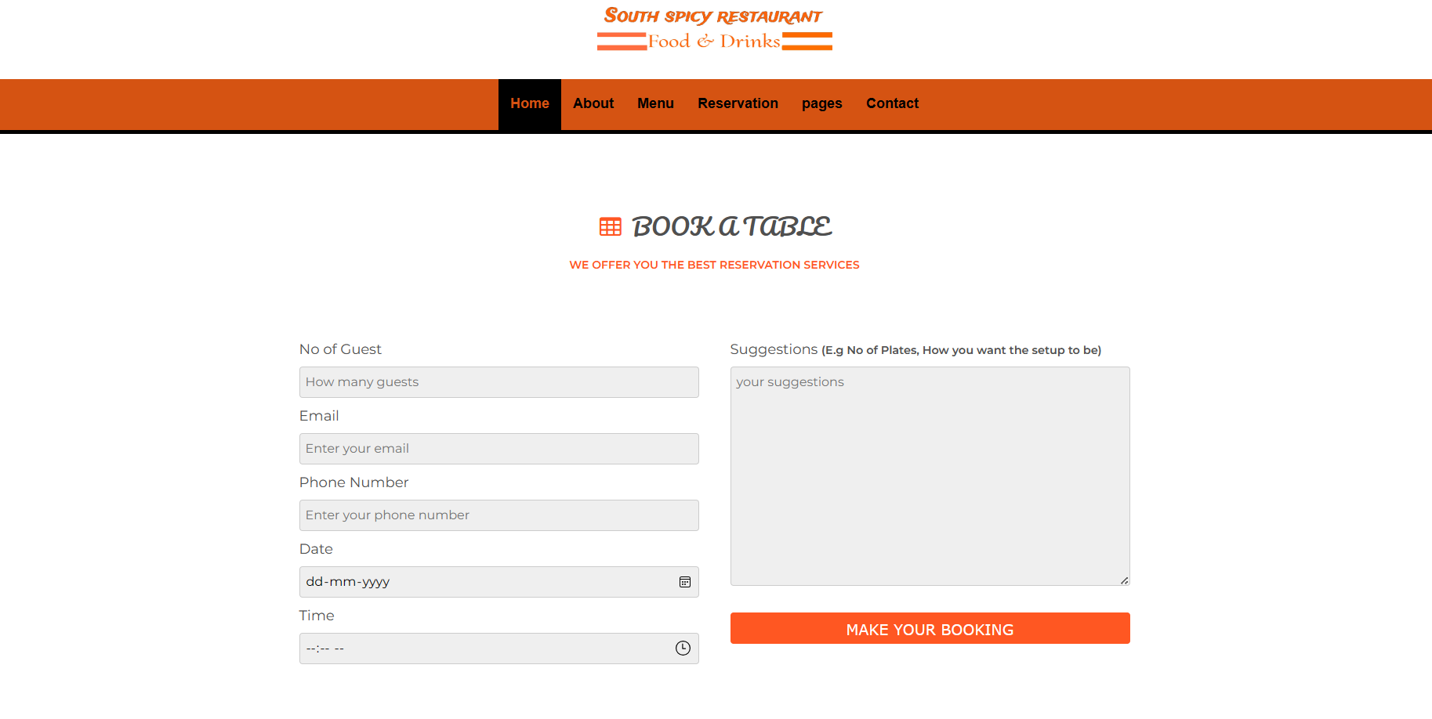
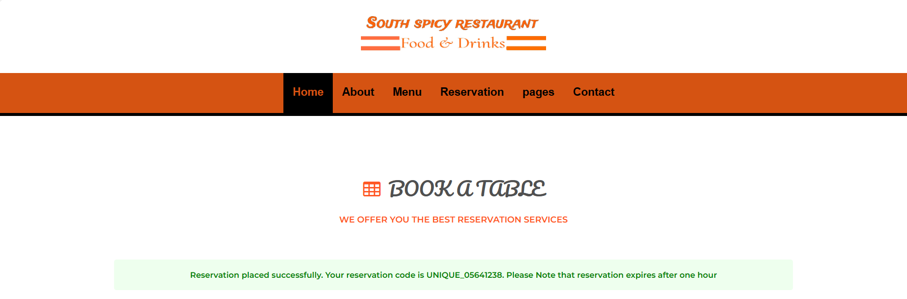
Results and Analysis
Improved Table Turnover
Optimization resulted in faster table turnover and increased revenue.
Enhanced Customer Satisfaction
Positive feedback and reviews from customers due to reduced wait times and improved service.
Operational Efficiency
Streamlined operations and better resource utilization resulting in cost savings.

Slide 8
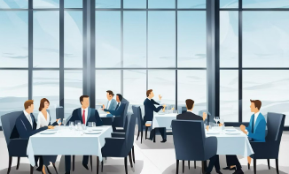


Conclusion
Satisfied Customers
Business Impact
Operational Excellence
Delivering a superior dining experience with seamless and efficient table reservations.
Positive impact on revenue and business growth through improved operational efficiency.
Efficiently managing table reservations for a smooth and organized restaurant workflow.

Slide 9
References
HTML (Hypertext Markup Language):
https://developer.mozilla.org/en-US/docs/Web/HTML
CSS (Cascading Style Sheets):
https://developer.mozilla.org/en-US/docs/Web/CSS
PHP (Hypertext Preprocessor):
https://www.php.net/
MySQL:
https://dev.mysql.com/doc/
Bootstrap (Front-end Framework):
https://getbootstrap.com/docs/5.1/getting-started/introduction/

Slide 10
Thank you

